Slide 1




Spatial Analysis of Crime Rates in San Francisco
Project Submitted By:
Santhosh Kumar Jayavel (20250813)
Module: CS621B Spatial Databases

Slide 2
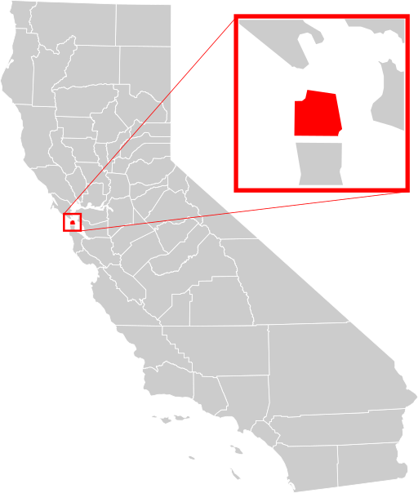
Crime Overview in San Francisco
San Francisco has been experiencing a rapid increase in the crime rate due to increasing immigration, wealth disparity, and racism.
San Francisco has become the first city in the US to declare an emergency to tackle increasing levels of crimes, directing extra funds for programmes aimed at reducing criminal activities.

Slide 3
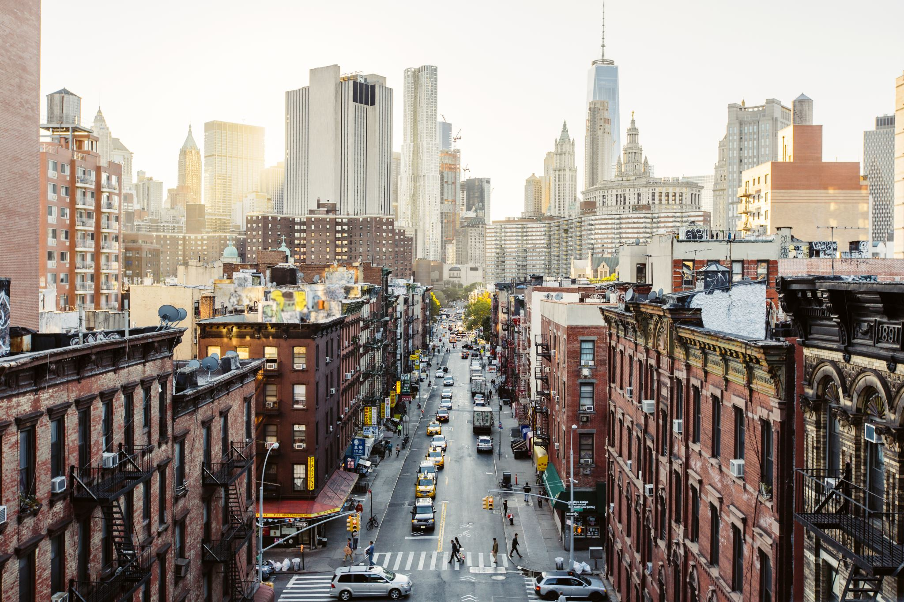
Problem Statement
San Francisco Police Department aims to strengthen its operations and infrastructure facilities to reduce crime rates by uncovering crime patterns.

Slide 4
Analysis Overview
Visualize
Visualize all the crime occurred between 2018 and 2020
Highlight
Highlight the most crime affected district using choropleth
Find
Find crime occurred areas with minimal police infrastructure
Analyse
Analyze the part of a day that experiences a lot of crimes
Rank
Rank top three crimes between 2018 and 2020 on a yearly basis
Highlight
Highlight the street that experiences majority of crime

Slide 5
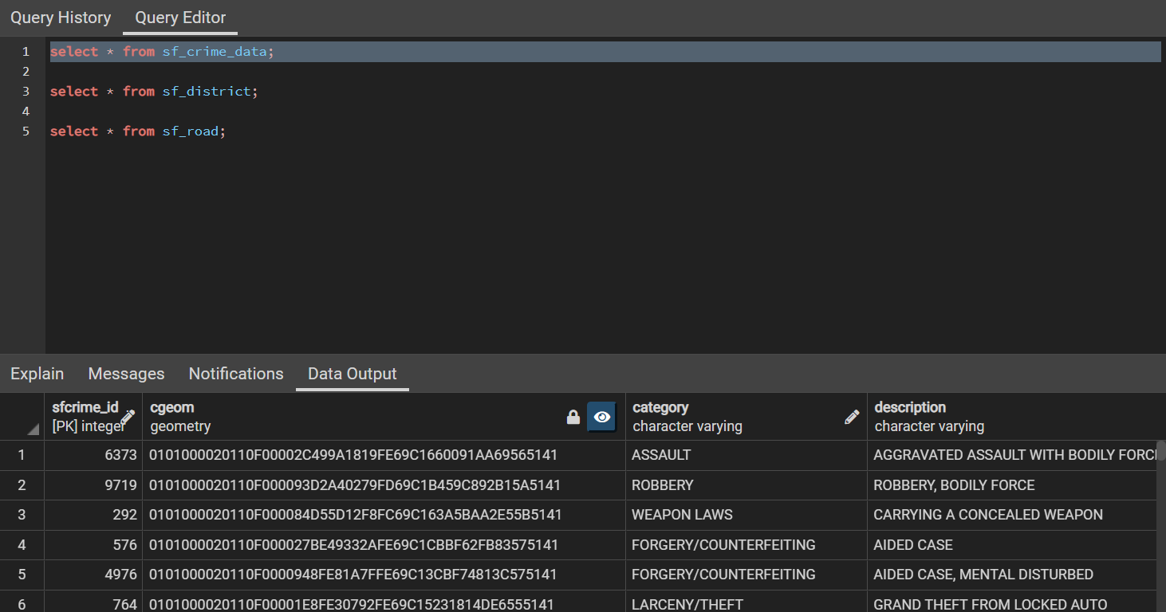
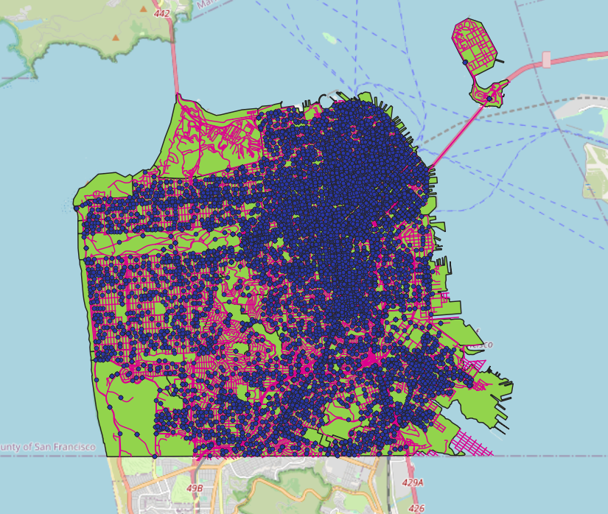
Visualize crime data points in San Francisco

Slide 6
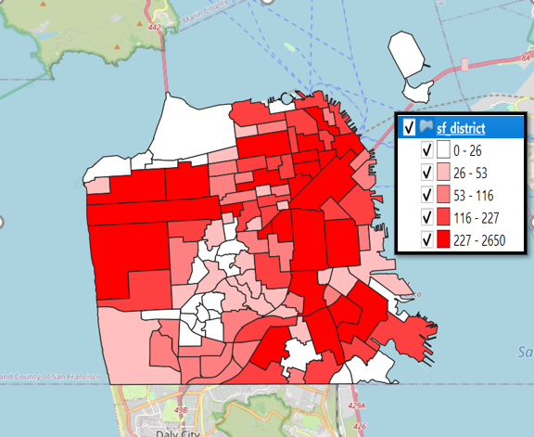
Highlight the most crime affected district using choropleth

Slide 7
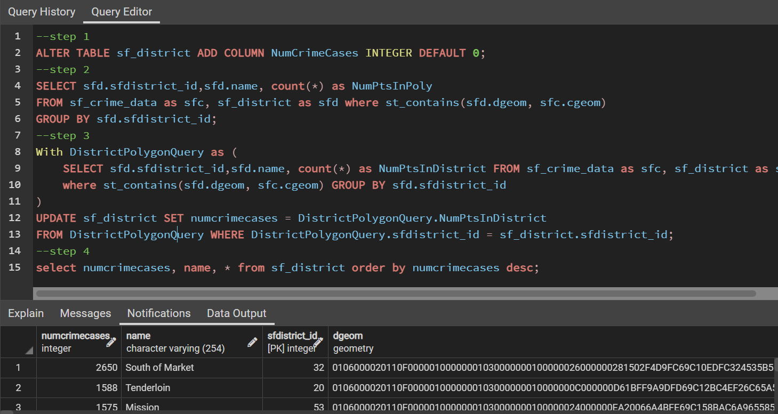
Highlight the most crime affected district using choropleth

Slide 8
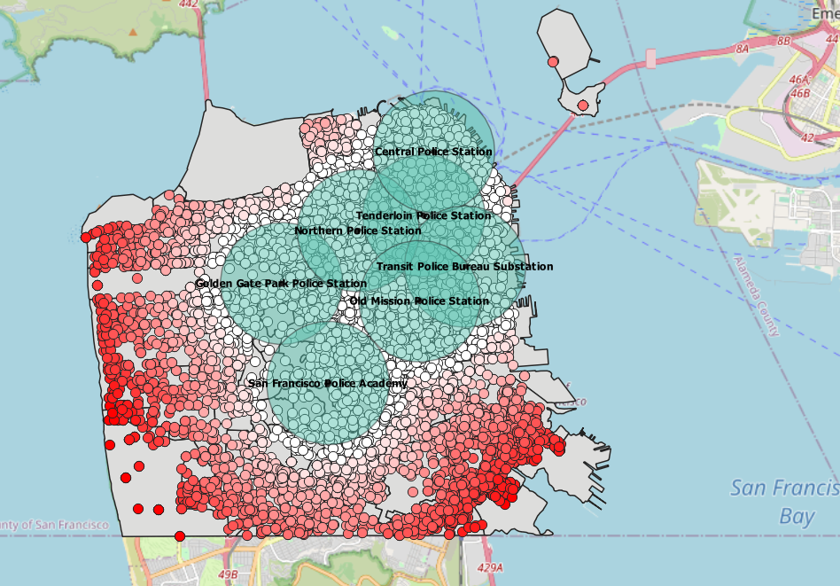
Find crime
occurred areas with minimal police infrastructure

Slide 9
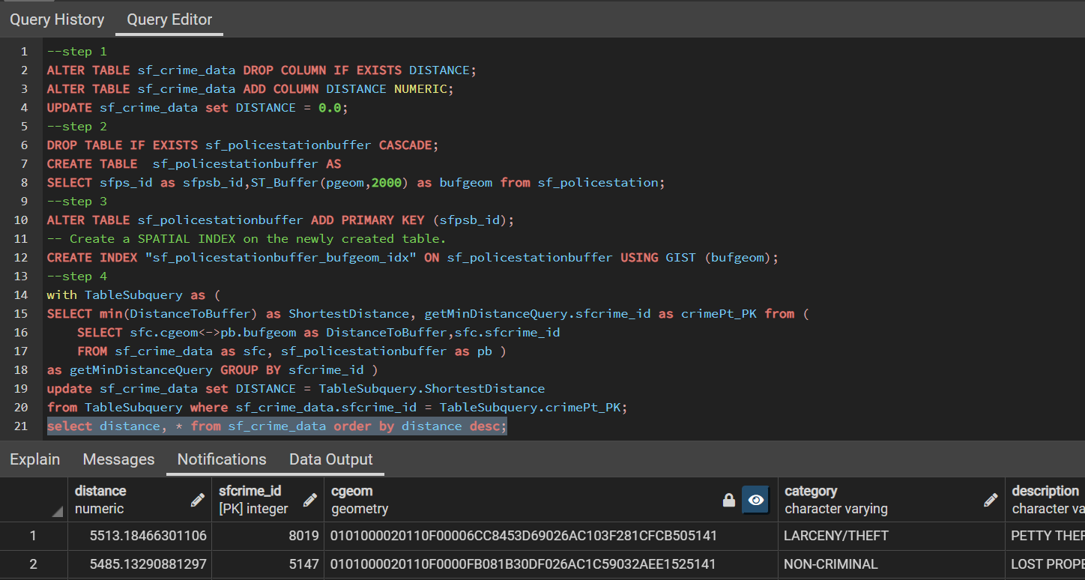
Find crime
occurred areas with minimal police infrastructure

Slide 10
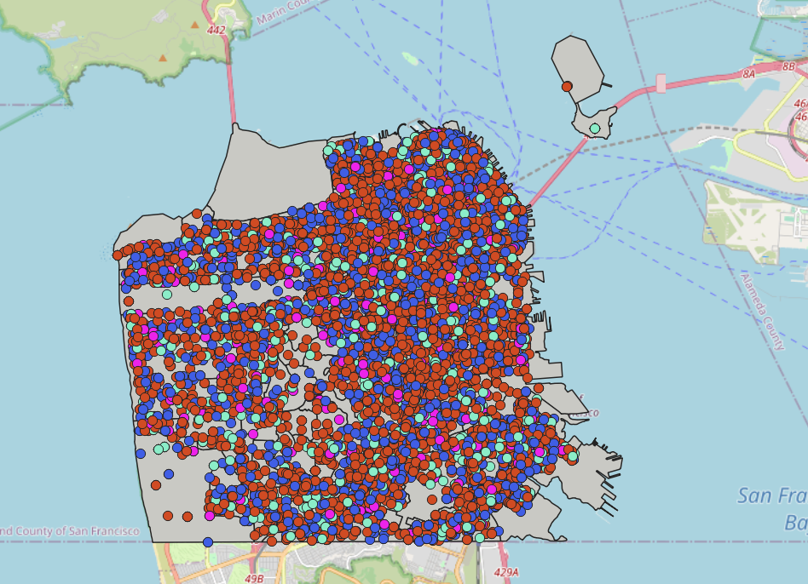
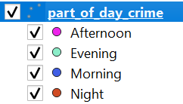
Analyze the part of a day that experiences a lot of crimes

Slide 11
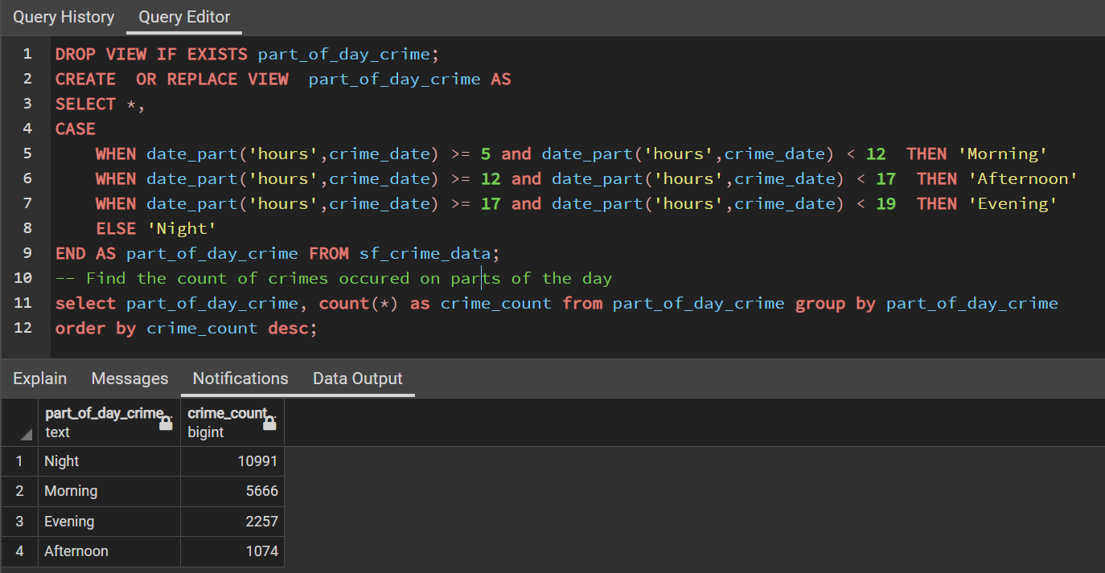
Analyze the part of a day that experiences a lot of crimes

Slide 12
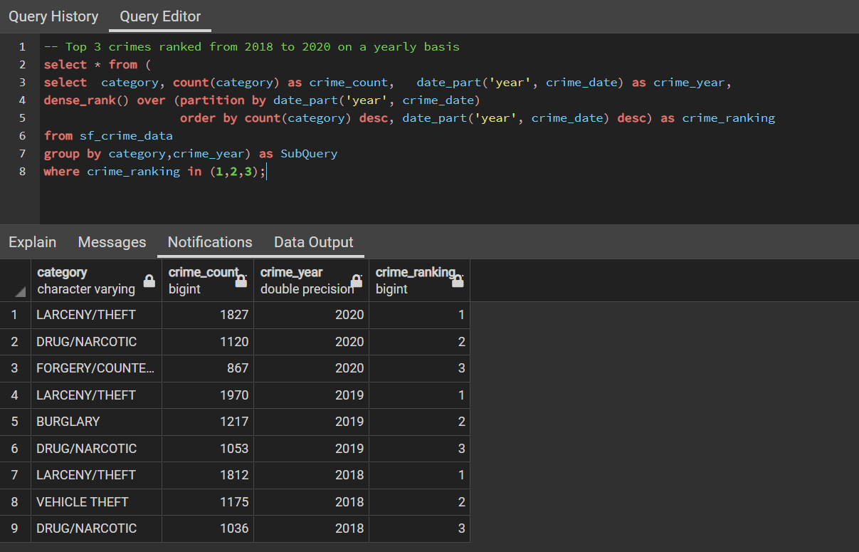
Rank top three crimes between 2018 and 2020 on a yearly basis

Slide 13
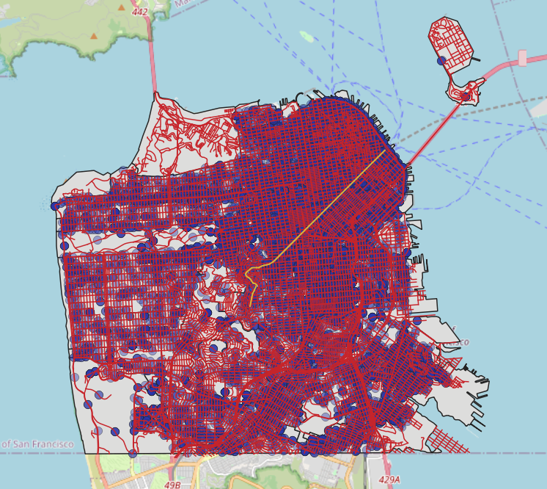
Highlight the street that experiences majority of crime

Slide 14
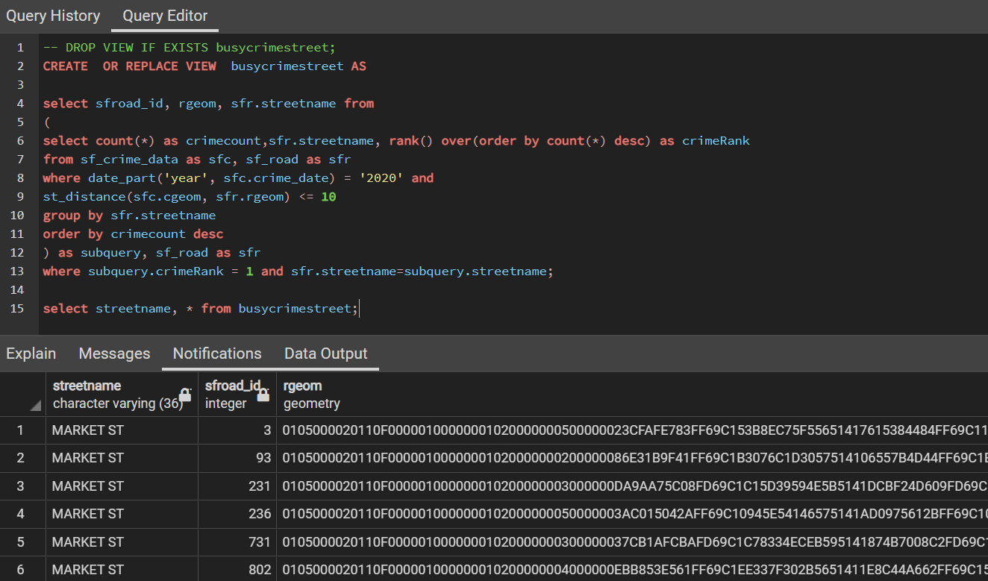
Highlight the street that experiences majority of crime

Slide 15

Thank You

